Slide 1

Linear Regression Chapter-01
Dr. Deepak Mehta

Slide 2

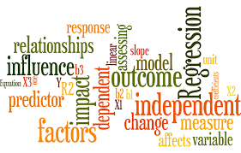
Agendas
Basic Intuition
Linear Regression Equation
Regression vs Correlation Coefficient
Linear vs Multiple Linear Regression
Seaborn Libraries Method plot
Scatterplot

Slide 3
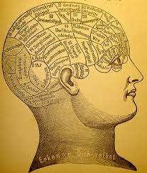
Basic Intuition
Linear regression strives to show the relationship between two variables by applying a linear equation to observed data.
One variable is supposed to be an independent variable, and the other is to be a dependent variable.
For example, the weight of the person is linearly related to his height.
Hence this shows a linear relationship between the height and weight of the person. As the height is increased, the weight of the person also gets increased.

Slide 4

Linear regression is a supervised algorithm that learns to model a dependent variable, y, as a function of some independent variables (aka "features"), xi​, by finding a line (or surface) that best "fits" the data.
In general, we assume y to be some number and each xi​ can be basically anything.
For example: predicting the price of a house using the number of rooms in that house (y: price, x: number of rooms) or predicting weight from height and age (y: weight, x​i: height, age).

Slide 5
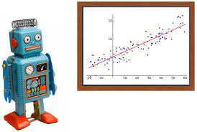
Linear Regression Equation
The measure of the extent of the relationship between two variables is shown by the correlation coefficient.
The range of this coefficient lies between -1 to +1.
This coefficient shows the strength of the association of the observed data for two variables.
A linear regression line equation is written in the form of:
Y = a + bX
where X is the independent variable and plotted along the x-axis
Y is the dependent variable and plotted along the y-axis
The slope of the line is b, and a is the intercept (the value of y when x = 0).

Slide 6
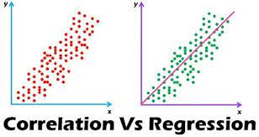
Correlation vs Regression
The most commonly used techniques for investigating the relationship between two quantitative variables are correlation and linear regression.
Correlation quantifies the strength of the linear relationship between a pair of variables, whereas regression expresses the relationship in the form of an equation.
Note:
Use correlation for a quick and simple summary of the direction and strength of the relationship between two or more numeric variables.
Use regression when you're looking to predict, optimize, or explain a number response between the variables (how x influences y)

Slide 7
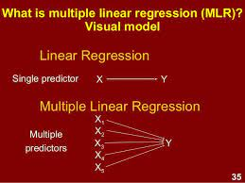
Linear Vs Multiple Linear Regression
The very most straightforward case of a single scalar predictor variable x and a single scalar response variable y is known as simple linear regression.
The equation for this regression is represented by;
y=a+bx
The expansion to multiple and vector-valued predictor variables is known as multiple linear regression, also known as multivariable linear regression.
The equation for this regression is represented by;
Y = a+bX
Almost all real-world regression patterns include multiple predictors, and basic explanations of linear regression are often explained in terms of the multiple regression form.
Note that, though, in these cases, the dependent variable y is yet a scalar.

Slide 8
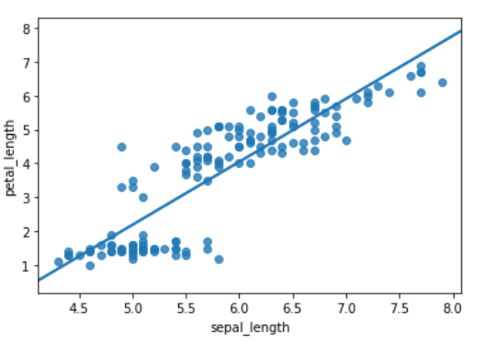
Seaborn Library
# importing libraries import seaborn as sb # load data df = sb.load_dataset('iris') # use regplot sb.regplot(x = "sepal_length", y = "petal_length", ci = None, data = df)

Slide 9
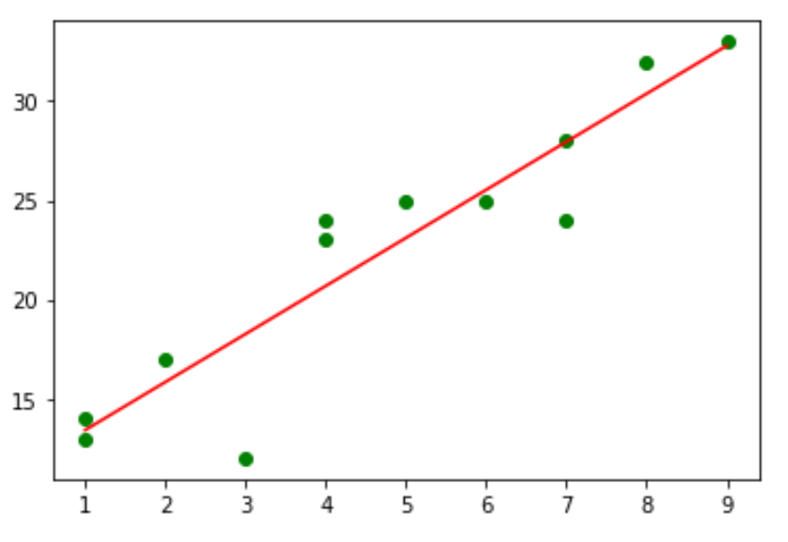
Scatter Plot : Relationship
#use green as color for individual points
plt.plot(x, y, 'o', color='green’)
#obtain m (slope) and b(intercept) of linear regression line
m, b = np.polyfit(x, y, 1)
#use red as color for regression line
plt.plot(x, m*x+b, color='red')
It is not necessary that here one variable is dependent on others, or one causes the other, but there is some critical relationship between the two variables. In such cases, we use a scatter plot to imply the strength of the relationship between the variables.
If there is no relation or linking between the variables, the scatter plot does not indicate any increasing or decreasing pattern.

Slide 10
Thank you
Deepak.e11296@cumail.in
9812881611

